Slide 1
Prediction of Fraud Transactions Using Data Mining Techniques
Sateesh Chandra Kammanethi
X16134800

Slide 2
Introduction
In current generation everyone doing transactions so there might be occurrence of fraud in that.
So here we are going to predict fraud detection accuracy using different types of data mining techniques (i.e Decision tree, Random forest and Logistic Regression etc.).

Slide 3
Methods and Implementation
Decision Tree Algorithm:
Decision tree is a flow chart like structure, each non-leaf node denotes test on attribute and each leaf node holds class label.
Random Forest Algorithm:
It consists of tree like structure, it uses selected set of data and with particular features.
Logistic Regression Algorithm:
To apply Logistic Regression we need categorical variable i.e the variable should be either 1 or 0 (i.e true or false respectively).

Slide 4
Results and implementation
Decision Tree:
First we need to load the data into Rapidminer and apply Decision tree algorithm.
By using this algorithm we can detect the fraud transactions with accuracy of 96.13%

Slide 5
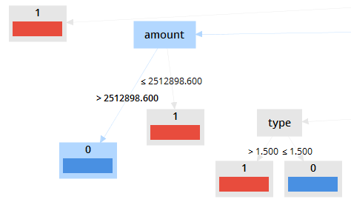
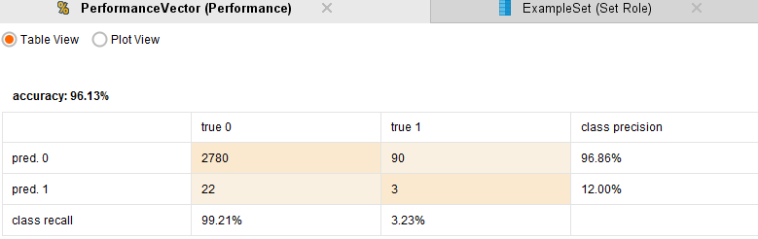

Slide 6
Random Forest Algorithm:
In Random Forest algorithm it uses selected number of rows and columns with particular set of features.
By using Random Forest Algorithm we can detect the fraud transactions with accuracy of 96.79%.

Slide 7
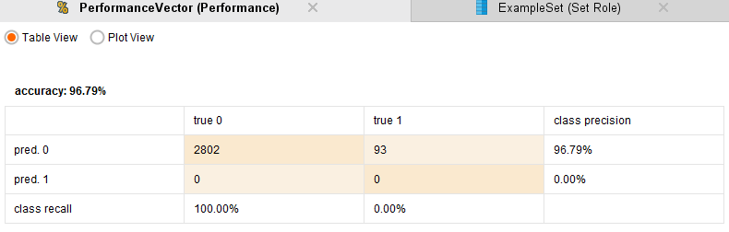

Slide 8
Logistic Regression Algorithm:
If we need to apply Logistic Regression the dependent variable should be categorical.
In Logistic Regression Algorithm we can able to detect the fraud transactions with accuracy of 96.55% .

Slide 9
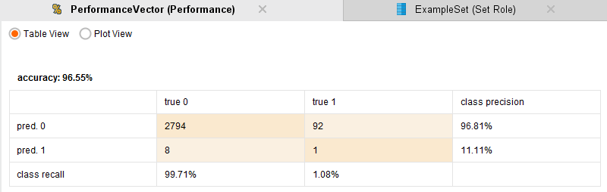

Slide 10
Conclusion
To detect fraud transactions data mining techniques are best since we can get high accuracy.
If we apply Decision tree, Random forest and Logistic regression algorithms we will get the accuracy percentage of 96.13, 96.79 and 96.75 reapectively.

Slide 11
References
Freund, Yoav, and Llew Mason. "The alternating decision tree learning algorithm." icml. Vol. 99. 1999.
Breiman, L., 2001. Random forests. Machine learning, 45(1), pp.5-32.
Gislason, P.O., Benediktsson, J.A. and Sveinsson, J.R., 2006. Random forests for land cover classification. Pattern Recognition Letters, 27(4), pp.294-300.

Slide 12
Lemeshow, S. and Hosmer Jr, D.W., 1982. A review of goodness of fit statistics for use in the development of logistic regression models. American journal of epidemiology, 115(1),pp.92-106.
Bhargava, N., Sharma, G., Bhargava, R. and Mathuria, M., 2013. Decision tree analysis on j48 algorithm for data mining. Proceedings of International Journal of Advanced Research in Computer Science and Software Engineering, 3(6).

Slide 13
Thank you

